Slide 1

Modeling Public Mood to Detect Event
By :- Prashant Tomar and Rohit Chaudhary
Old Dominion University, USA

Slide 2
Introduction
As huge portion of the population is present on social media.
Where they share about their life in forms of post on multiple platforms.
Which reflects the mindset of the society.
These posts when analyzed can answer a big question of what is happening where they live.
This information can be used to detect the sentiment of the society.
These sentiment and the tense of the post could be used to detect an event.
Based on large twitter corpus of published twitter posts, we'll look specifically at the interplay between public mood and event outcomes.

Slide 3
Abstract
We performed the analysis on twitter corpus collected from the different timelines accordingly to event.
We will do a psychometric analysis to find mood states from the collected tweets.
Then compute a mood vector for each timeline of the event.
There were three mood states which we used in our analysis, which are as follows- Positive, Negative and Neutral.
We tried to find the impact of events in social, economical and political sphere on the various dimensions of public mood.
Performed large scale analysis of mood which helped to build solid platform to model intensive trends in terms of there predictive value, the mood during the event and aftermath of the event.

Slide 4

Why sentiment to detect and event
It has been noted that tweets normally fall in one of two different types - either talk about themselves or primarily to share information.
In both cases, tweets can be regarded as the microscopic essence of the mood.
Here we have tried to explore how public mood changes, which we’ll find by conducting a sentiment analysis of tweets published.

Slide 5
Data and Timeline
The data used for analysis is taken from twitter.
The event occurred was on 9th July, 2022.
We have scrapped popular hashtags trending in that region relevant to the event.
The timeline for the analysis is 2nd May 2022 to 2nd July 2022 as pre-event.
From 3rd July 2022 to 16th July 2022 as Event.
From 17th July 2022 to 16th August as post-event.

Slide 6
Parameters of Analysis
We have combed through the Twitter feed looking for the most popular hashtags in that area during that time period.
The following is a list of the most common hashtags that we use: gotagohome OR gotagoranil OR srilankaeconomiccrisis OR gohomegota OR gohomemahinda OR gohomerajapaksas OR gogotago OR srilankacrisis OR lka OR fuelcrisislk OR srilanka demonstrations
Then tweets were filtered according to Date, Time, Hashtags, username, and retweets.
We avoided tweets that included links and only hashtags.
Using hashtags we have included the original tweets and avoided conversations from replies.

Slide 7
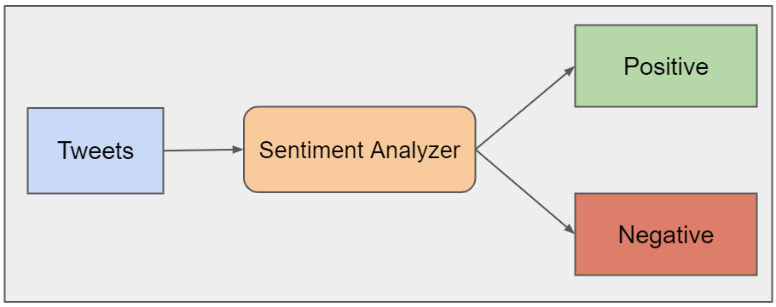
Methodology
We used the Web-Scraping methodology.
we eliminated the stopwords and used the nltk package.
Iteratively process the regular expression tokenizer in order to refine the dataset even further.
The CSV file that contains the original tweets was created.
It is categorized so that a sentiment score could be calculated. The score for the negative category is zero, and the score for the positive category is one.

Slide 8
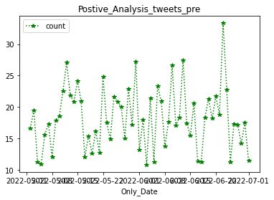
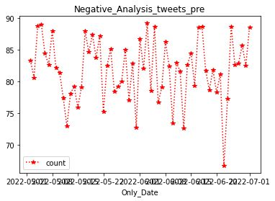
Results Pre Event

Slide 9
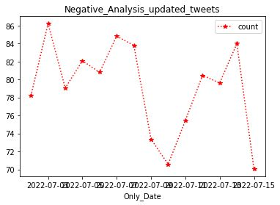
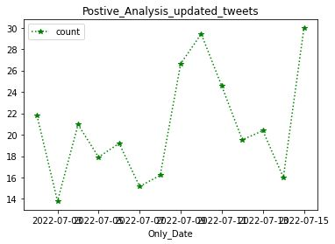
Results During Event

Slide 10
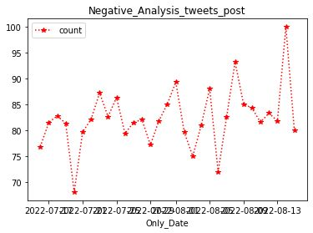
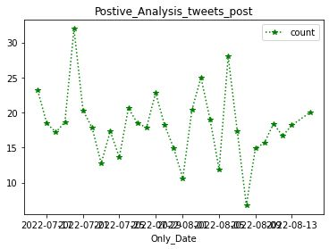
Result Post Event

Slide 11
Findings from the Result
In the Pre-Event data set we can see that the percentage of the sentiment of the tweets was less positive and majorly negative on the graph.
Which has deflections and are changing constantly when tending towards the event, i.e the number of percent of negative tweets is increasing daily when nearing the event.
The During dataset shows a very high percentage of negative tweets with saturation in the positive percentage of tweets.
This is reversing but not drastically in the post-event dataset as there is an increase in the number of positive tweets while cruising away from the event.

Slide 12
Problems Faced
There is only a limited amount of data available from twitter and takes a very long time to authenticate the user key.
The data needs to clean according to the specific use case.
Removing the stop words changes the tone of the tweets.
The relevant data set remaining after cleaning becomes comparatively smaller than the original corpus.
Becomes very tough and tricky when tweets are in different languages.
Had to be very careful to find repetitive and junk tweets with similar hashtags.

Slide 13
Future Scope
Event detection is itself a field of study.
We could add user behavior and have analyzed tweets narrowing down to hours and check whether the trend changes between morning and night.
Can implement a tweet discussion analyzer for the in-depth sentiment.
Entity recognition can have a great impact in finding how it can mobilize the mood of the public.
Part of speech recognition will help derive the tone of the tweets.
Different approaches to data collection will have more accurate and precise outcomes.
Considering more events from the world will give a more accurate understanding of the sentiment of the public.

